Slide 1
Math. for CS
Ch 4- Mathematical Data Types
Prof. Shunxiang Zhang
Anhui University of Science & Technology
Computer Science and Engineering
Mobile Phone：189-6377-7827
Email：sxzh666@gmail.com;sxzhang@aust.edu.cn

Slide 2
Topics covered/Contents
4.1 Sets
4.2 Sequences
4.3 Functions
4.4 Binary Relations
4.5 Finite Cardinality

Slide 3
Ch 4- Mathematical Data Types
We have assumed that you’ve already been introduced to the concepts of sets, sequences, and functions, and we’ve used them informally several times in previous sections. In this chapter, we’ll now take a more careful look at these mathematical data types. We’ll quickly review the basic definitions, add a few more such as “images” and “inverse images” that may not be familiar, and end the chapter with some methods for comparing the sizes of sets.

Slide 4
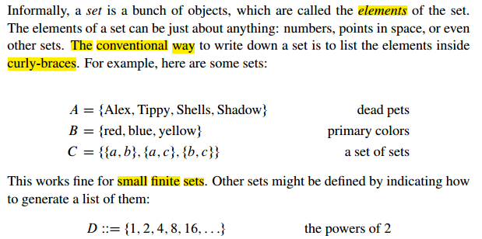
4.1 Sets

Slide 5
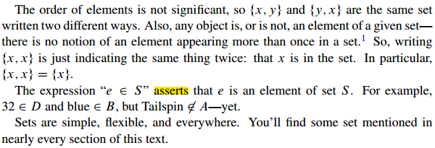
4.1 Sets

Slide 6
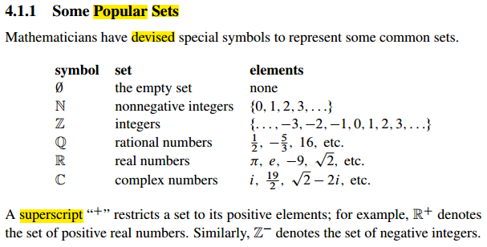
4.1 Sets
Notes:
subscript

Slide 7
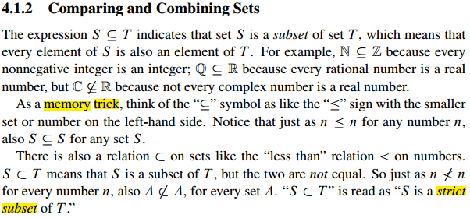
4.1 Sets

Slide 8
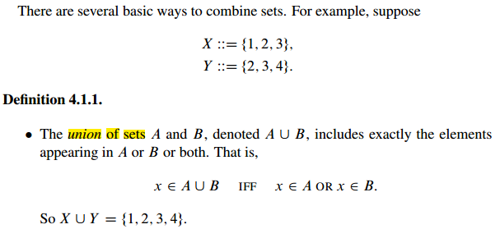
4.1 Sets

Slide 9
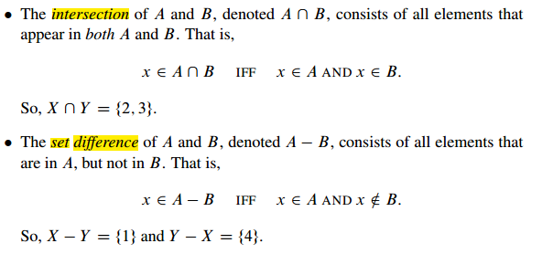
4.1 Sets

Slide 10
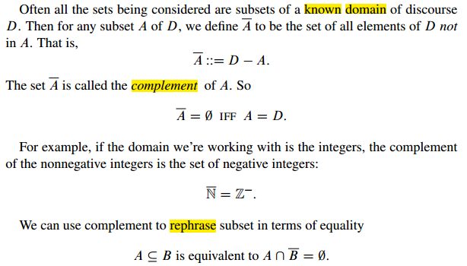
4.1 Sets

Slide 11
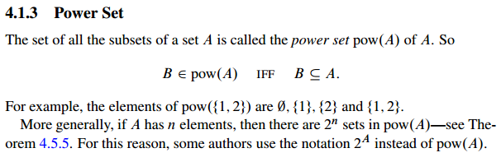
4.1 Sets

Slide 12
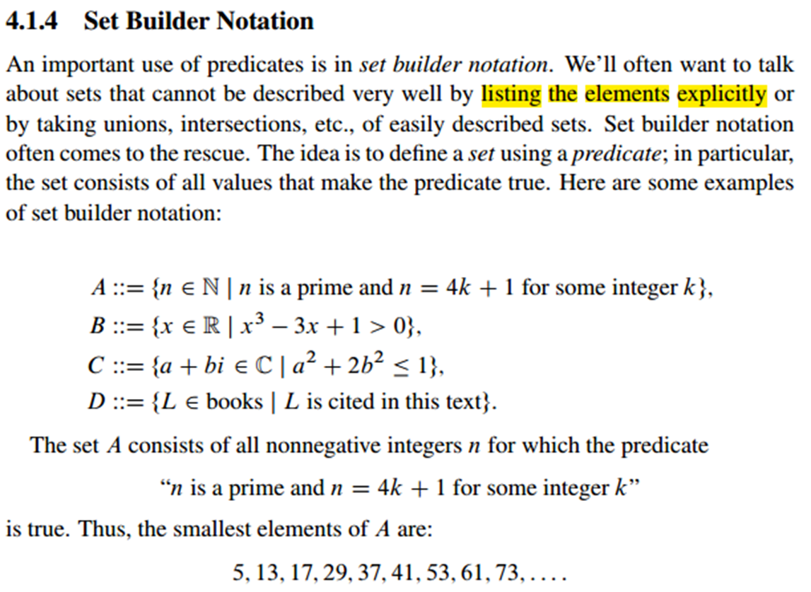
4.1 Sets

Slide 13
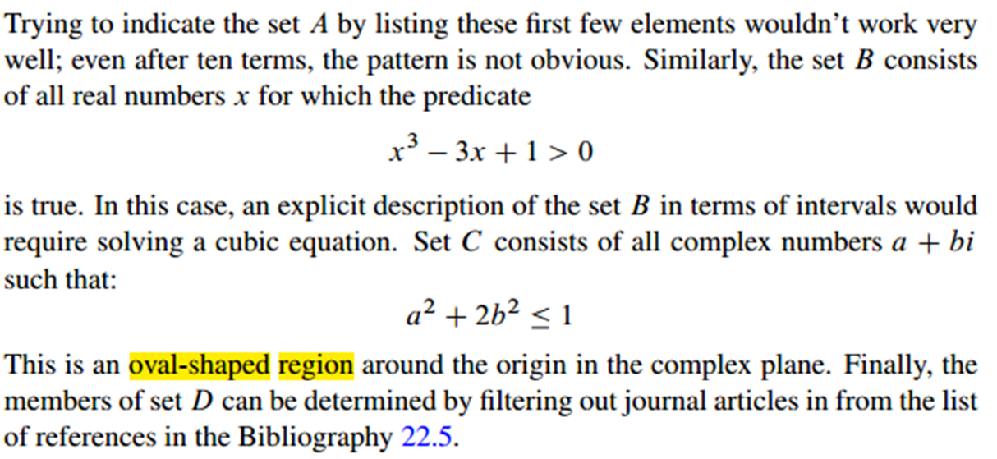
4.1 Sets

Slide 14
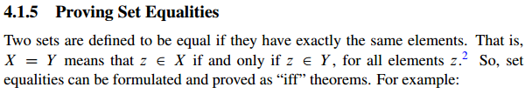

4.1 Sets

Slide 15
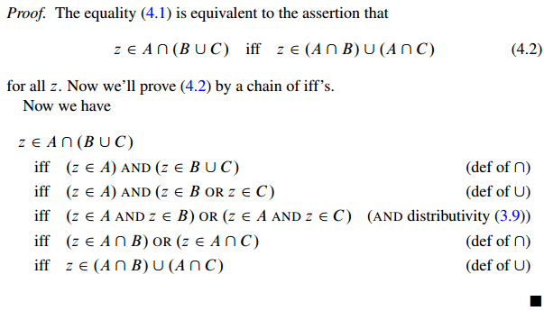
4.1 Sets

Slide 16
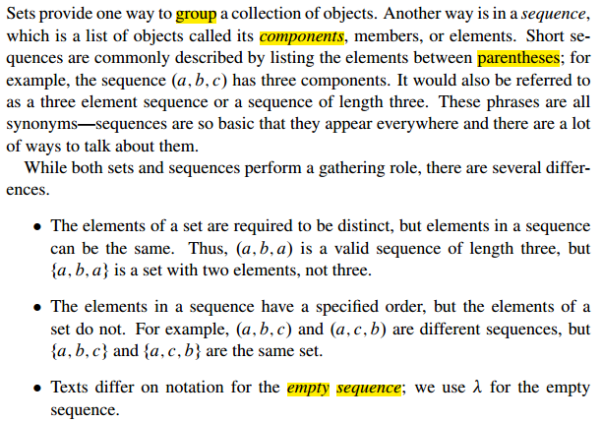
4.2 Sequences

Slide 17
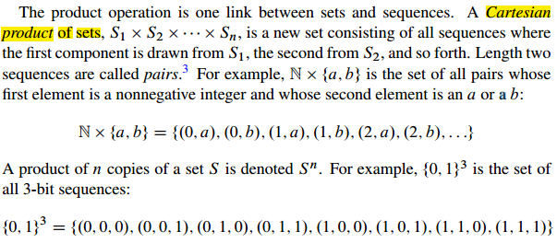
4.2 Sequences

Slide 18
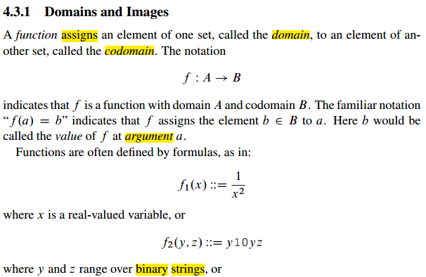
4.3 Functions

Slide 19
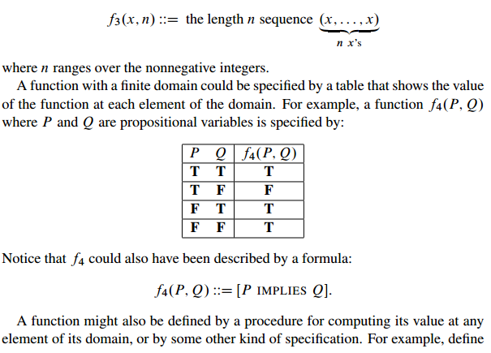
4.3 Functions

Slide 20
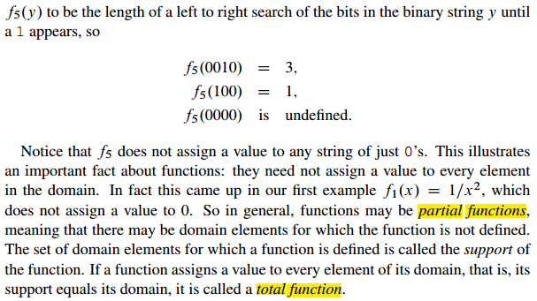
4.3 Functions

Slide 21
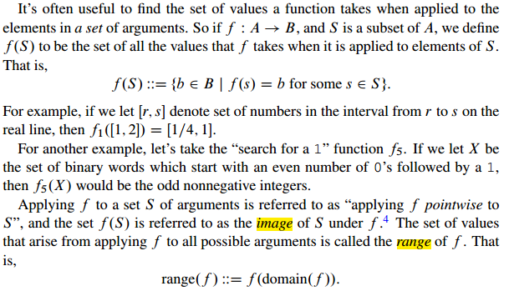
4.3 Functions

Slide 22
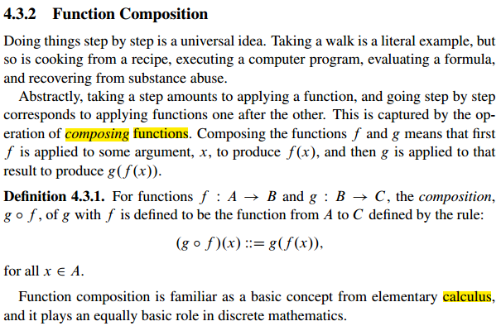
4.3 Functions

Slide 23
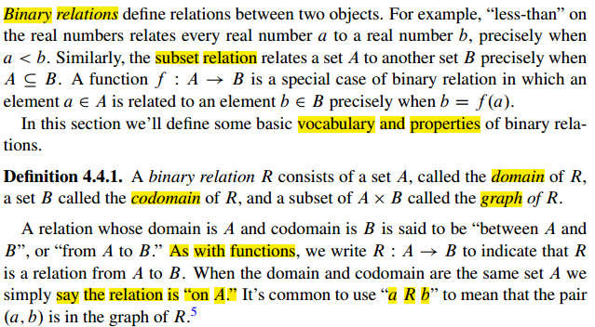
4.4 Binary Relations

Slide 24
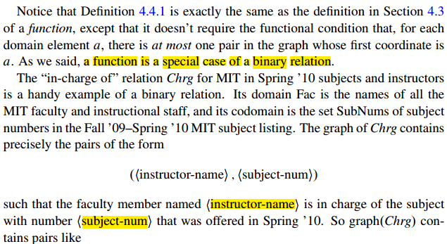
4.4 Binary Relations

Slide 25
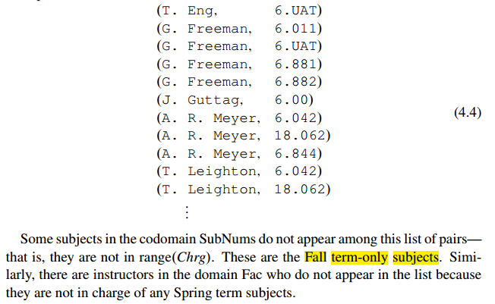
4.4 Binary Relations

Slide 26
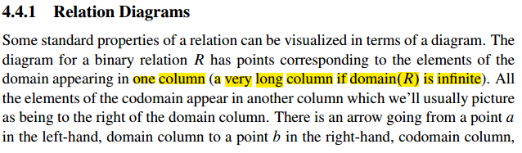
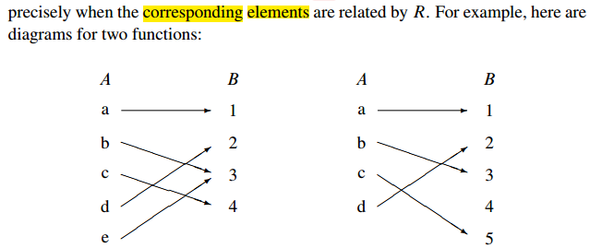
4.4 Binary Relations

Slide 27
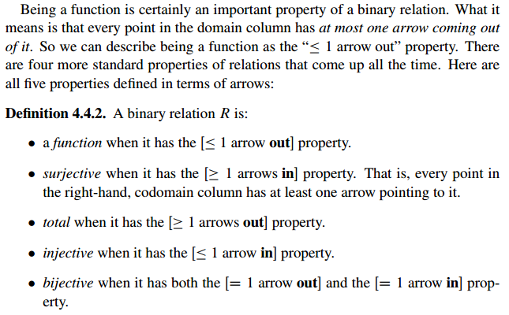
4.4 Binary Relations
Notes:
Surjective 满射， total 全映射

Slide 28
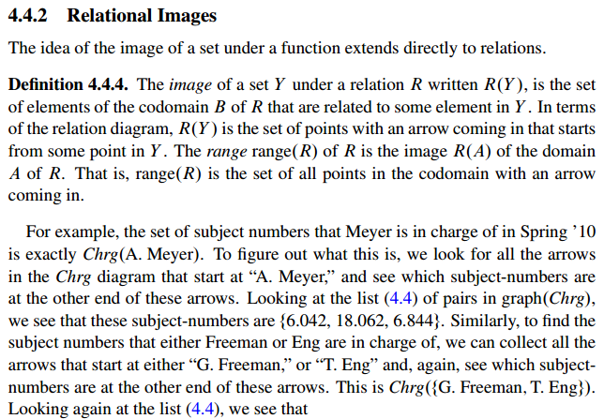
4.4 Binary Relations

Slide 29
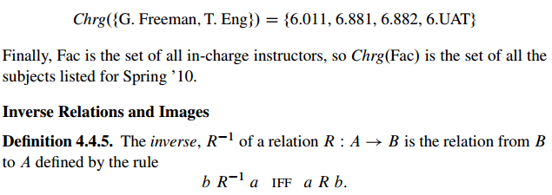
4.4 Binary Relations

Slide 30
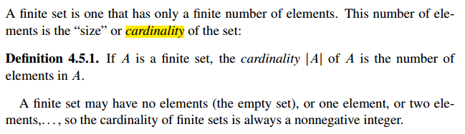
4.5 Finite Cardinality

Slide 31
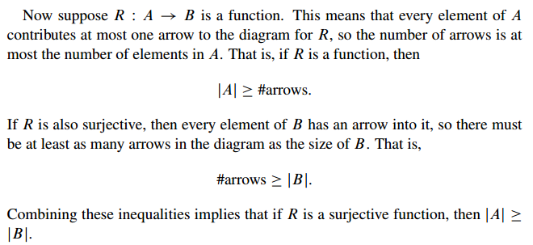
4.5 Finite Cardinality

Slide 32
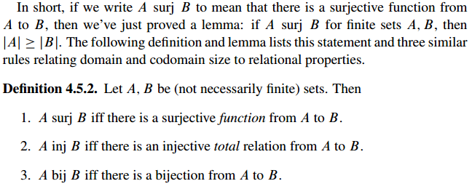
4.5 Finite Cardinality

Slide 33
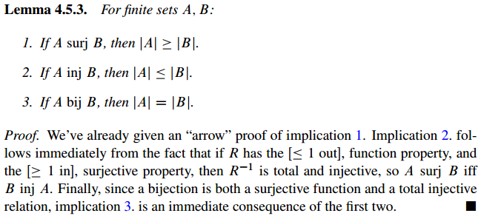
4.5 Finite Cardinality

Slide 34
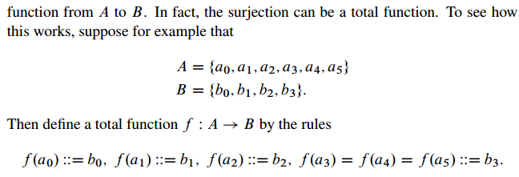
4.5 Finite Cardinality

Slide 35
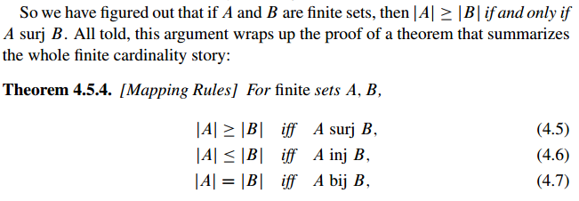
4.5 Finite Cardinality

Slide 36
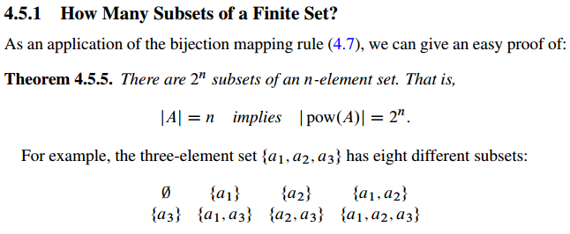
4.5 Finite Cardinality

Slide 37

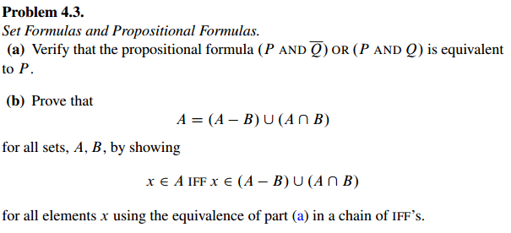
4.6 Group/Panel discussion
Group 1

Slide 38
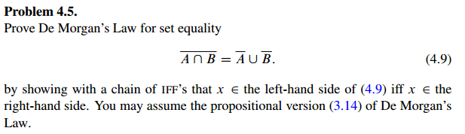
4.6 Group/Panel discussion
Group 1

Slide 39
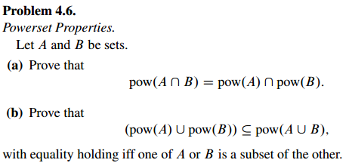
4.6 Group/Panel discussion
Group 1

